Slide 1
SPECTRUM INDUSTRIES
By
JEEVAN SALDHANA
Notes:
Spectrum Industries

Slide 2
Introduction

Slide 3
Spectrum Industries
Founded in 1993
Manufacturing Color Sorters
Headquartered in Mangalore
On the West Coast Of India
Notes:
SPECTRUM INDUSTRIES is a company that was incorporated in 1993 and commercial production commenced in 1994 with the manufacture of the first Electronic color sorters made in India.
It is headquartered in Mangalore, which is Karnataka’s second largest city and a major port city on India’s west coast and is situated at Industrial Estate, Yeyyadi, mangalore. The Electronic Color Sorters are assembled in this Unit, where the main office is also located.

Slide 4
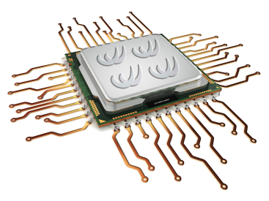
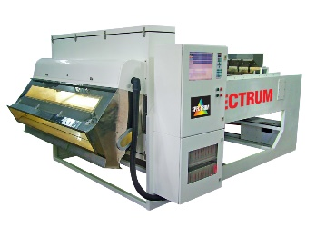
Growth & Progress
Shifted to Microprocessor Based Color Sorters in 1997
Established Second Unit in 1997
Diversified into manufacture of
Pre Cleaners
Destoners
Hullers
Gravity Separators
Graders
Notes:
Starting with analog photo detector based Color Sorters, Spectrum Industries subsequently Developed advanced microprocessor based Color Sorters in 1997.
In the year 1997, with the establishment of a second unit, Spectrum Industries diversified into the manufacture of the entire range of grain milling machines such as Pre Cleaners, De-stoners, Hullers, Gravity Separators, Graders etc.

Slide 5
Machines Manufactured By Us
Electronic Color Sorter
Gravity Separator
Vibro Cleaner
Vibro Grader
De Stoner
Coffee Huller
Peeler Polisher
Aspirator
Husker for Pulses
Belt Conveyor
Bucket Elevator
Rotary Air Lock

Slide 6
A few MACHINES FOR CASHEW
DELIVERING COMPETITIVE ADVANTAGE
THROUGH ARTIFICIAL INTELLIGENCE & MACHINE LEARNING TECHNOLOGIES

Slide 7
Camera Color Sorter
High Resolution 5048 pixels CCD Cameras.
LED Solid state high intensity long life stable lightning.
On-line live visual display of product being sorted on 15” Colour LED TFT screen.
Ultra-fast long life pneumatic ejectors with response time of 1ms and life of up to 5 billion cycles.
Automatic cleaning of viewing area by wiper system.
Automatic online calibration with self-check procedures.
Fully computer controlled.

Slide 8
Belt Type Color Sorter
24
Hrs Operation
Ideal for sorting brittle products such as Cashewnuts, Almonds, Raw & Blanched Peanuts etc., as well as non-free flowing material such as Raisins, Fresh & Dehydrated Vegetables such as Onion, Garlic, Carrot Cubes etc
Available in capacities ranging from 0.5 to 5 tons per hour
100
95%
Accuracy
Kgs Throughput

Slide 9
Hawk Eye-200
9
Grades in One Pass
24
Hrs Operation
200
95%
Accuracy
Kgs Throughput

Slide 10
Hawk Eye-100
9
Grades in One Pass
24
Hrs Operation
100
95%
Accuracy
Kgs Throughput

Slide 11
Complete Processing Plant Setup( Turnkey)
Complete turnkey processing plant setup
For cashew, coffee, tea, rice, pepper etc…
One-point accountability
Experience across global markets
End-to-End Warranty Support
Annual Maintenance Contracts

Slide 12
Track Record of The Company
27 years of experience
1600 machine installations
For
45 different applications
Installed in over 30 countries
Employing 150 skilled employees

Slide 13
Manufacturing Unit-I

Slide 14
Manufacturing Unit-II

Slide 15
Manufacturing Unit-III

Slide 16
Manufacturing Unit-IV

Slide 17
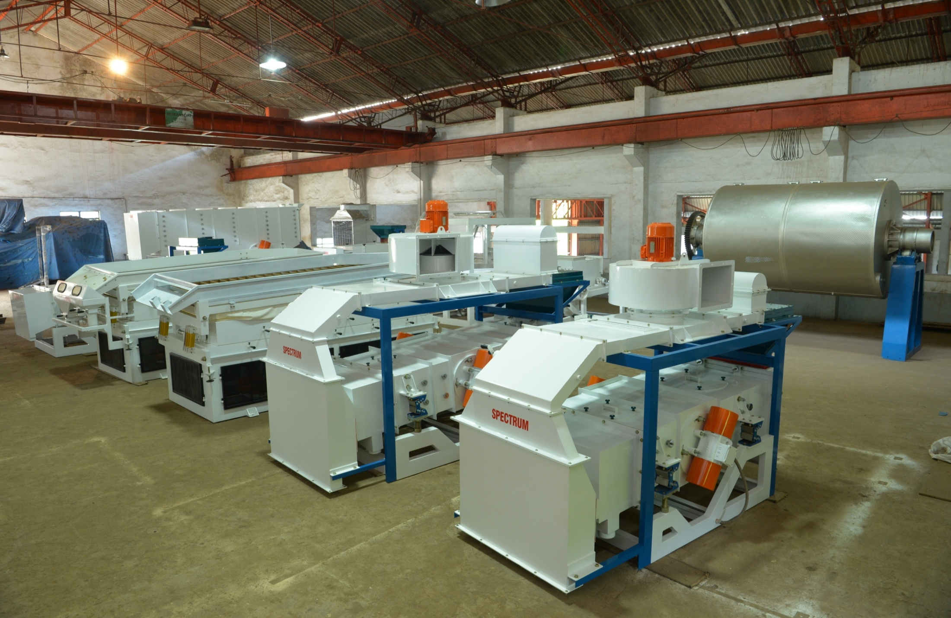
Machine Assembly Area

Slide 18
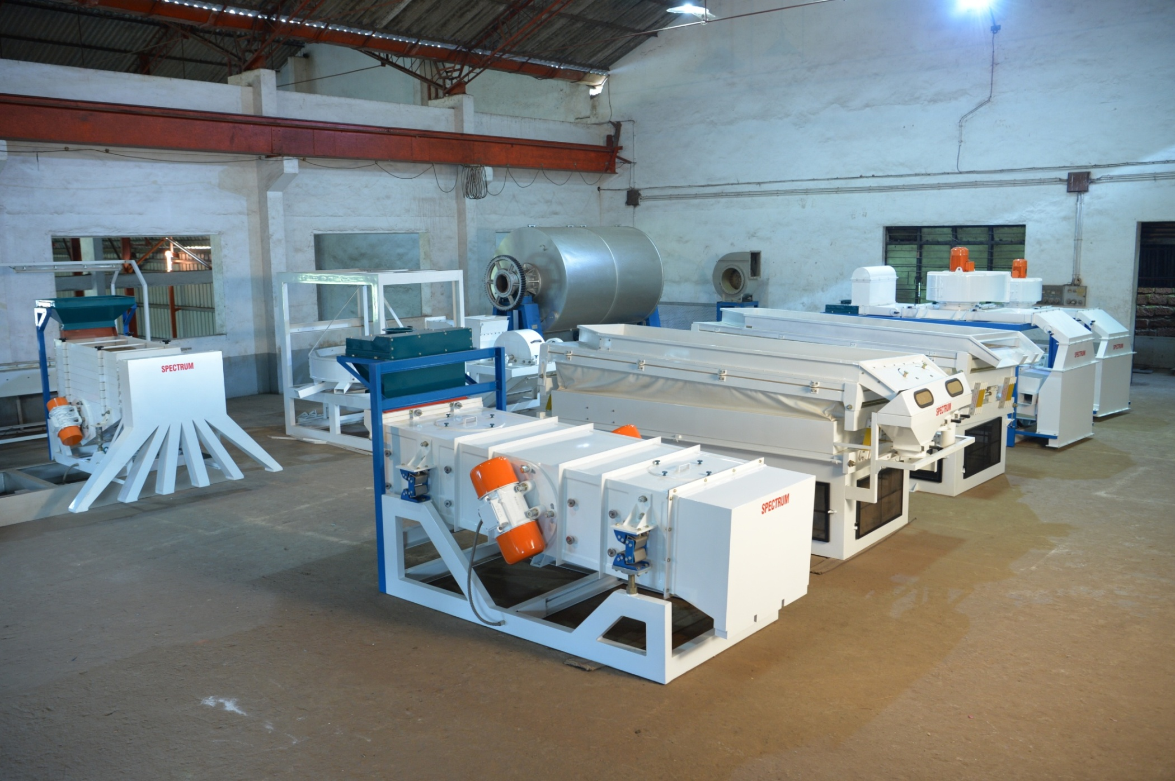
Machine Assembly Area

Slide 19
Manufacturing Equipment @ Spectrum
CNC Water Jet Cutting
German Messar CNC Plasma Cutting
200 Ton Hydraulic CNC Press Brake
Product Design & CAD Tools
Best in Class Materials for construction of machines

Slide 20
Scale Up of Manufacturing Unit
4 Manufacturing Units
60,000 sq.ft of Built Up Area
On 3.5 Acres of Prime Industrial Area
Fully Equipped Exclusive R&D Centre in Bhavnagar Gujarat.
Notes:
Spectrum Industries has four manufacturing units in Baikampady and Yeyyadi spread over 3.5 Acres of prime Industrial land with over 60,000/- sq. ft. of Built up area with Modern amenities.
We have an exclusive research and development department centre located in Bhavnagar in Gujarat

Slide 21
Customers In
Asia,
Africa,
Far East,
Australia,
Russia,
& the U.S.A.

Slide 22
Certifications
ISO 9001:2015 certified for the
Design,
Manufacture
Supply of electronic color sorters.
By the British Standards Institute since the year 2001
Conformity European
CE Certified

Slide 23
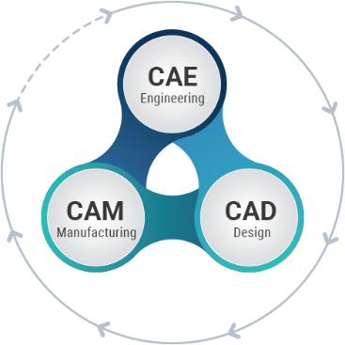
Recognition as a Design House
The Company gets recognition as a design house.
1997
1998
Setup R & D Unit
Recruits B.Tech & M.Tech Grads
In 1999
In 2000
Staff Training Centre is setup
Notes:
The constraint of access to Technology for its growth was solved by having an In-house R & D set up having the best brains working rigorously to develop new products and to further improve its existing products.
The issue of non-availability of Skilled Manpower in Teir -2 cities, where Spectrum Industries is based, was addressed by providing orientation and on the job training to new employees and also identifying the training needs and providing training to existing employees through External and Internal Faculty.
The company also tries to recruit qualified and experienced personnel whenever possible and as needed. And this twin approach has helped to company overcome this major challenge.

Slide 24
R & D Centre in Bhavnagar, Gujarath

Slide 25
Patents
Two Stage Reversible Air Circulation Dryers for drying of Coffee and other Agricultural produce.
Identification and sorting of up to five types of Polymers using Near Infrared Spectroscopy
Optical Stalk Extractor for Tea processing

Slide 26
Many First’s To Our Credit
Pioneers in Optical Sorting in India since 1993.
Introduced Patented Two stage reversible air dryers for Coffee.
Use of Backward curve turbines in Gravity separators.
Use of Forward curve turbines in Centrifugal Blowers.
Dynamic balancing of all turbines.
First to use ABD mounts from Sweden in Vibratory Cleaners & Graders to minimize vibrations of the main frame for smooth and silent operation.

Slide 27
Many Firsts To Our Credit
Counter balanced decks in Double deck Graders for smooth operation to minimize vibration.
Use of 2 K paints with Epoxy Zinc Phosphate primers and phosphating to prevent rust formation and enhance product life.
Use of Electroplated fasteners bolts, nuts on all exposed parts.
Powder coating of internal components such as gates, louvers etc. in Gravity separators for smooth operation and longevity.

Slide 28
Many First To Our Credit
Internal wiring provided with P clips and terminals in Cleaners, Destoners, Gravity Separators and other major machines.
Siemens make motors with Bonfiglioli Gear Boxes as standard offering.
Use of heavy gauge material with higher factor of safety which is usually twice that of the nearest competitors.
Very few breakdowns due to superior design and better manufacturing techniques and practices providing almost nil down time.
Best after sales service in the Industry which is recognized by all clients in India across the globe.

Slide 29
Achievements
Pioneer in Color Sorters in India
Released Camera Based Sorting Machine for
Coffee
Tea
Pulses
Cashew
Etc.
First Company to use CCD Cameras by sourcing them from the USA.
Developed a Bulk sorter for food grains using this technology.
Notes:
Spectrum Industries is the pioneer in the manufacture of Electronic Color Sorters in India.
In the year 2000, Spectrum Industries released the state of the art Camera based system for sorting Products like Coffee, Tea etc. and was the first company to incorporate CCD(Charge Coupled Device) Cameras in Colour Sorting Machines, by sourcing them from the US and developing a Bulk Sorter for food grains using this technology.

Slide 30
Achievements
Introduced Line scan CCD Camera based color sorters for the food processing industry.
Started Exporting machines in the year 2000
Customers in over 25 Countries such as
Ukraine
Cyprus
Nigeria
Sudan
Ethiopia
& other countries in Africa , Asia & Far east
Including Developed Countries like USA & Australia

Slide 31
Achievements
27 years of Experience in
Designing
Developing
Manufacturing
Colour sorting & other processing machines
Over 1600 installations of colour sorters worldwide apart from thousands of other machines

Slide 32
Achievements
Our color sorters
Pioneered CCD Camera based sorting machines
Available in both Chute based & Belt feed types
Incorporated with cutting edge Artificial Intelligence & Machine Learning Algorithms and are the best available sorters in the world today.

Slide 33
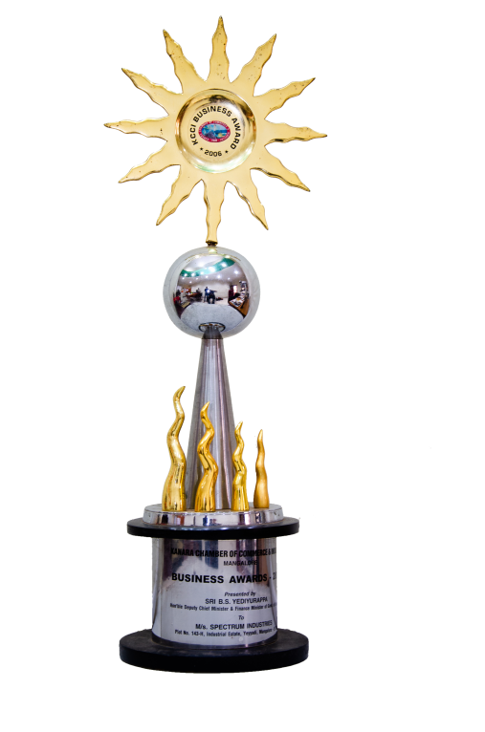
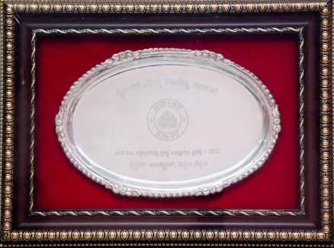
Awards & Recognitions
Sri Vishveshwaraya Manufacturing Excellence Award 2017
FKCCI Business Excellence Awards 2018
KCCI Business Award 2006

Slide 34
Vishveshwaraya Award

Slide 35
FKCCI Award

Slide 37
Thank You

